Slide 1

Nashville Housing Market Analysis
LiU CHENXI

Slide 2
Motivation, Data and Process:
Motivation
Understand the house value and rental trend after 2008.
Analysis the nowadays housing market, the position of Nashville housing market and the potential of growth rate of Nashville market.
Critical thinking the elements that may influence the housing value.
Main data resource
Zillow
US census
fred.stlouisfed.org
Method
Python
Excel

Slide 3
The Reasons Of Picking Up Three Cities: Los Angles, Atlanta, Nashville
Population, Metro area– (US census 2020)
Los Angeles County(CA): 10,014,009
Atlanta (Fulton County, GA): 1,066,710
Nashville (Davison County, TN): 929,744
https://www.census.gov/programs-surveys/popest/technical-documentation/research/evaluation-estimates/2020-evaluation-estimates/2010s-cities-and-towns-total.html
GDP (millions)
CA: $3,290,170
GA: $673,072
TN: $411,689
Reasons of picking these 3 cities.
Los Angeles as one of major cities in the highest GDP state. It presents the ceiling of US housing value.
Atlanta and Nashville are two capitals in their own states. Medians believe that the Nashville will become the next Atlanta. Atlanta and Nashville has a lot of commons from geography, weather, etc.

Slide 4
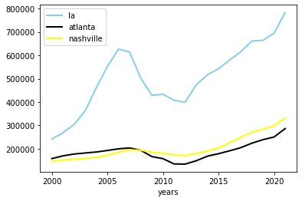
Analysis:
The Average Housing Price Trends In Three Cities (2000-2021 )
There is a huge gap between LA and other two cities. (Considering the public translation and mobilization convenience, they might cause the gap)
Nashville house average price gained 126% to comparing with Atlanta 81% in 20 years.
There was significant drop during the 2008-2013 in the LA and Atlanta. However, Nashville house price didn’t receive the same impact as other two.
- Zillow

Slide 5
Rental Costs In Three Cities (graph 1) - Zillow
Year | LA | Atlanta | Nashville
2014 | $1776.5 | $1099 | $1167
2015 | $1899 | $1153.5 | $1250
2016 | $2021 | $1222 | $1319.5
2017 | $2127 | $1290 | $1368.5
2018 | $2219 | $1365.5 | $1407.5
2019 | $2304.5 | $1444 | $1466
2020 | $2322.5 | $1500.5 | $1509.5
2021 | $2430.5 | $1708 | $1642.5
The average cost of rental in 3 cities are getting more expensiver each year.
The rental costs in Atlanta and Nashville in 2021 is still in LA 2014 level.
Costs in Atlanta is leading the year change rate. The rental charge in Nashville still have room grow.
Changes(2014 – 2021): | 26% | 35% | 28%

Slide 6
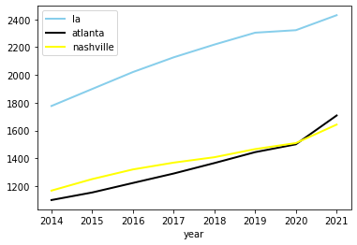
Analysis:
In graph-2,The average of Nashville is slightly higher than Atlanta until 2020.
Considering the city population and size, Nashville has the positive sign for rental profitability since 2014.
While the city growth, the Nashville rental properties will be more valuable.
- Zillow
The Average Rental Cost Trends In Three Cities( 2000-2021 ) (graph 2)

Slide 7
The Possible Elements That Influent The House Price - Mortgage Rates
The Mortgage was 8.15% in 2000 and 3.1% in 2021 now. The changes between 20 years is 5.05%
The average rate from 2008 – 2010 was 5.26%. The 2019 – 2021 is 3.34%.
US Federal Reserve more likely keep the same rates until the end of 2022 or 2023. The potential buyers will show more interesting by the low rates in general.
Question: What will happen if the Mortgage rate back to the 2008 -2010 level?
- fred.stlouisfed.org

Slide 8
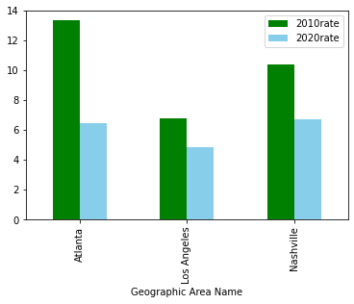
The Possible Elements That Influent The House Price – Housing Unit Vacancy Rate in Metro areas
Housing Unit Vacancy Rate From 2010 – 2020
According to Bloomberg, the health housing vacancy rate is 6%-7% (Bloomberg.com)
LA has surprisingly low vacancy rate in 3 cities and significantly getting lower during the decade.
Atlanta has the biggest difference from 13.34% in 2010 to 6.46% in 2020. Nashville vacancy rate reduced 3.69%.
Nashville housing vacancy rate is in the healthy rate. Therefore, the market has no supply issue to meet demand.
US Census
https://www.investopedia.com/terms/v/vacancy-rate.asp#:~:text=Vacancy%20rates%20are%20a%20very,to%20the%20area's%20vacancy%20rate.&text=Low%20vacancy%20rates%20mean%20there,a%20certain%20building%20or%20area.

Slide 9
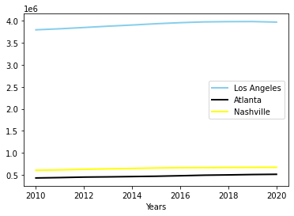
The Possible Elements That Influent The House Price – Population growth
Population changes From 2010 – 2020
None of three cities population growth showing the booming growth rate.
The population in Nashville metro doesn’t grow as Media news expected. The Nashville Metro area has more population than Atlanta.
we can expect the rental price in Nashville Metro area will be increasing during the years to match Atlanta level. However, the population that would like to live in the Nashville Metro area may show the opposite way.
- Us census

Slide 10
Summary:
Nashville metro housing marketing is still health level, and it doesn’t have supply issue to meet demand due to the vacancy rate.
The low mortgage rate will keep attracting potential buyers and builders as long as Federal Reserve would not change sharply in the currently years. It may be safe to invest Nashville even the time like 2008-2010.
The marketing of Nashville city applied successfully methods for branding the city to attract newer Nashvillians. The metro properties still have room for higher profit.
The population growth in Nashville does not skyrocketing growth as median expected. The metro rental costs may push new Nashvillians away to sub city for cheaper costs. Therefore, they will drive the sub-city development for housing service and value. It may case the vacancy rate high if the supply over demand.

